Slide 1


The mission of the Monroe County Industrial Development Corporation is to provide resources to qualified for-profit businesses and not-for-profit organizations that result in the retention and creation of jobs and employment opportunities in Monroe County and surrounding counties.
2025
COMIDA
Annual Board Report
March 24, 2026

Slide 2
2025 Results
Metric | 2025 | 2024
New Projects | 27 | 25
Company Investments | $340,047,153 | $193,357,386
Projected Direct Job Creation (3-year) | 465 | 704
Jobs Retained | 562 | 1,245

Slide 3
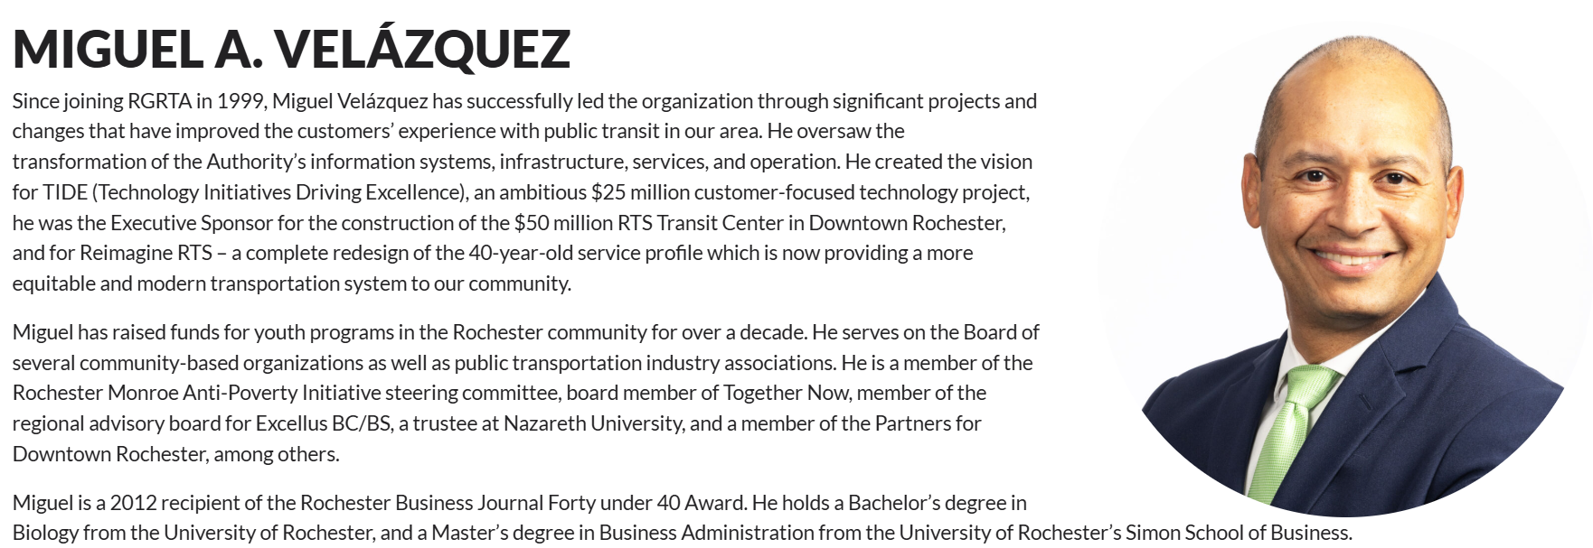
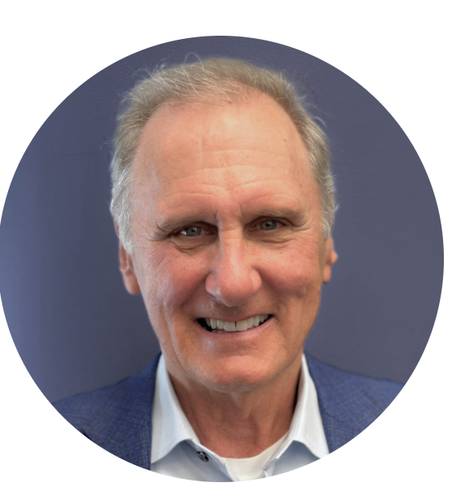
New Board Members
Brian Hickey
Miguel Velázquez

Slide 4
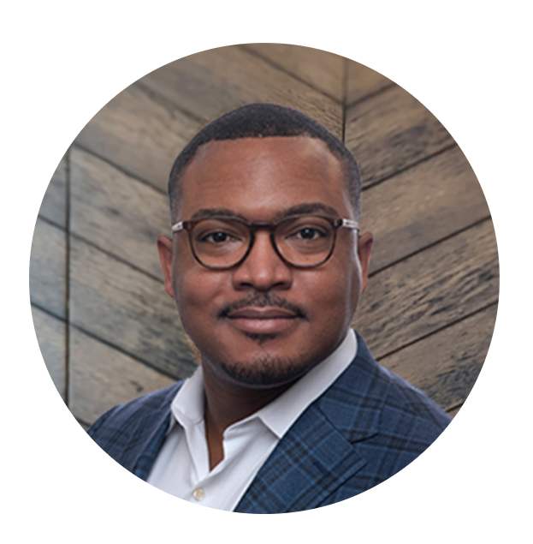
New COMIDA Chair in 2025 – Truman Tolefree

Slide 5
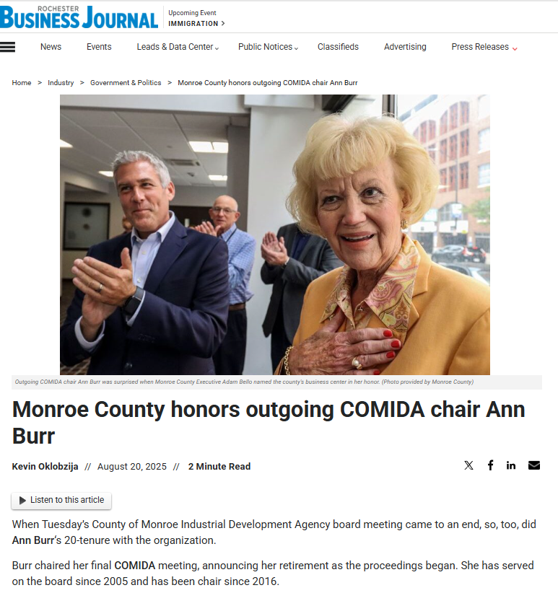
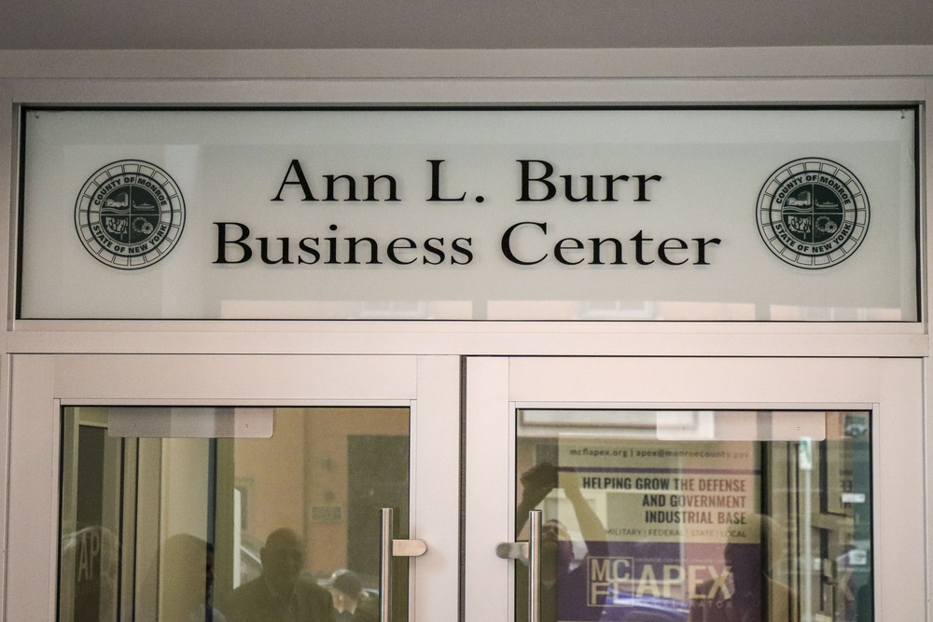
Ann Burr served on the COMIDA Board for 20 years, and as Chair for 9 of those years!
She provided steady leadership during challenging times, refocusing our mission and growing our impact

Slide 6
Approved Projects by Municipality
Brighton – 1
Chili – 2
Gates – 3
Greece - 3
Henrietta – 4
Honeoye Falls – 1
Irondequoit – 1
Perinton – 1
City of Rochester – 8
Sweden – 1
Webster – 2

Slide 7
QED Technologies
(Sales Tax Exemption)
QED Technologies International LLC, is renovating and expanding into a 20,000 square foot facility adjacent to their current location in the City of Rochester. This will create a state-of-the-art Optical Fabrication Innovation Hub. QED’s magnetorheological finishing platform redefines surface precision. This expansion will expand its capabilities beyond MRF, enabling new levels of precision and performance for advanced optics.
$3,800,000 project
43 new FTEs
Project is currently undergoing renovations

Slide 8
Precise Tool and Manufacturing, Inc.
(PILOT, Sales Tax & Mortgage Recording Tax Exemptions)
Precise Tool & Manufacturing Inc. is constructing a 40,000 square foot addition to their existing facility in the Town of Gates. This addition will support and grow the company’s manufacturing operations; making CNC machined components for customers in the automotive, rail, aviation, medical, and aerospace fields.
$3,600,000 million project
10 new FTEs
Construction is almost complete

Slide 9
McAlpin Industries, Inc.
(PILOT, Sales Tax & Mortgage Recording Tax Exemptions)
McAlpin Industries, Inc. is constructing a 300,000 square foot manufacturing facility in the Town of Webster. Completed in phases, phase one will encompass the construction of the initial 240,000 square feet. This facility will support McAlpin’s sheet metal fabrication business and house production lines capable of metal laser cutting, forming, welding, and powder coat finishing while also creating additional warehousing space.
$34,000,000 million
32 new FTEs
Project is currently under construction

Slide 10
Cascade District, LLC
(PILOT, Sales Tax & Mortgage Recording Tax Exemptions)
The proposed Cascade District project involves the renovation of an approximately 230,000 sq foot industrial building into a mixed-use development in the City of Rochester. The building currently houses 32 loft-style apartments as well as some commercial tenants. The existing lofts will undergo extensive renovations and an additional 58 one- and two-bedroom loft-style apartments will be constructed bringing the total number of residential units to 90. Additional commercial tenants will be sought to transform this space and bring new life to the area.
$22,700,000 million
1.5 new FTEs and new 58 new housing units
Project is currently under construction

Slide 11
Love Beets Production LLC
(Sales Tax Exemption)
Love Beets Production LLC is renovating and purchasing new equipment for its facility located at 1150 Lee Road in the Town of Greece. Love Beets is a food manufacturer specializing in beets and other root vegetables.
$1,130,000 million
11 new FTEs
Project is undergoing renovations

Slide 12
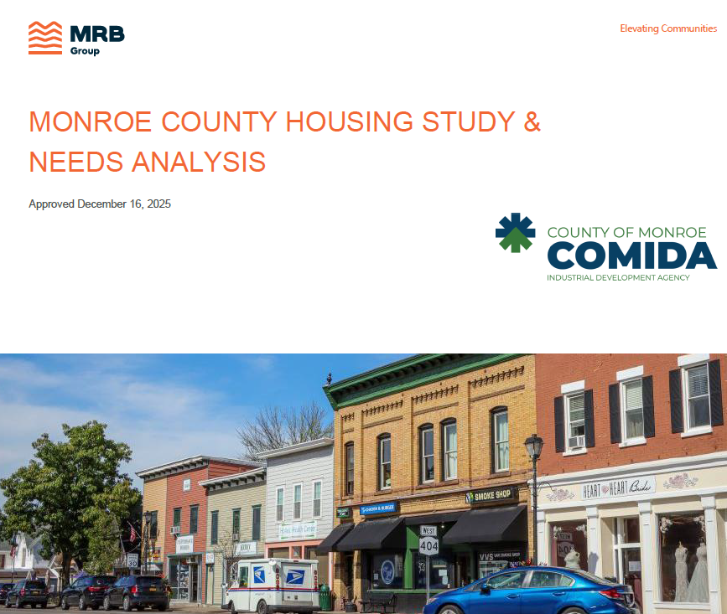
Meeting the Moment: COMIDA Housing Study
Key Findings:
~46% of renters are cost-burdened
Less than 1 month’s worth of housing inventory available to meet demand
New homes are ~$350K+ to build, but demand is strongest in the $120K–$260K range

Slide 13
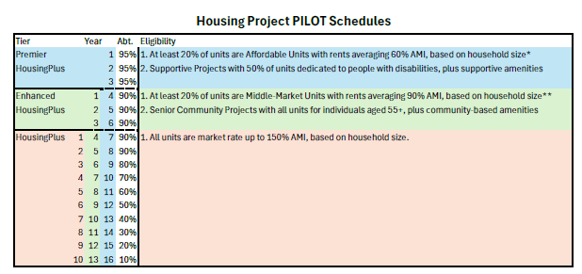
Meeting the Moment: COMIDA Housing Study
100s of new units in the pipeline for 2026 already!
Vistas at Highland Park
Orchard Place
Cascade
Clinton Square
Pittsford Oaks

Slide 14
Workforce Development Fund
Contributions over the years
Initial Investment of $2.5M
2022 allocation: $2,656,917
2023 allocation: $1,774,162
2024 allocation: $1,403,284
2025 allocation: $89,281
Total Investments 2022-2025: >$8,423,644

Slide 15
Program Highlights
IBERO American Action League – Workforce and Entrepreneurial Connections
160 job training and placement participants; 120 community health worker apprenticeships; 120 MWBE business enterprise participants; 75% completion rate across all components; 60% job placement rate across all components
TRACS- Training Rochester Adults in Construction Skills (UNICON)
Since program launch: 158 participants served; 94% graduation rate; 99% reside in Monroe County; 91% from underserved communities; 55 current apprentices.
YAMTEP – Youth Adult Manufacturing Training Employment Program
82% job placement rate, with graduates moving directly into manufacturing and related positions; strong employer partnerships and targeted skill-building ensure participants are workforce-ready and positioned for career growth.
RETAIN – Partnership with MCIDC and CampusROC (Chamber)
21 participants graduated in 2025; 35 anticipated graduates for 2025–2026.
mPower Program @ MCC – In-Demand Upskill Training
Over 1,300 residents trained including upskilling 480 healthcare workers; 3,391 employees from 110 businesses served.

Slide 16
Program Highlights
BOCES 2 – Orleans BOCES CDL Training Center
New test center launched in 2025; 93% CDL license passage rate; 69% students employed
Rochester ChildFirst Network – In-Home Daycare Business Support
12 new family child care businesses started; 120+ new families supported; 100 providers receiving assistance; 1,600 children receiving services.
Above The Line Foundation - Young CEO Program
27 graduates; 29 new businesses created by high school students
1199 SEIU Healthcare Career Pathways
66 participants enrolled with an 86% completion rate; 36% employed in critical health care rolls
RochesterWorks! Enhanced Recovery Training
74 job seekers served; 100% completion rate and 89% job placement rate; 34 participants were placed in unsubsidized employment.

Slide 17
Infrastructure Grant Updates
ESD FAST NY Shovel-Ready Grant Program – Tebor Rd (fairlife LLC site)
  $20M awarded for RGE electrical infrastructure upgrades to support $660M fairlife dairy processing site in Town of Webster
  $10.3M in project cost reimbursed to date
  Construction underway and is expected to be completed in 2026
NYSDOT Passenger & Freight Rail Assistance Program
  $3M awarded for upgrades to railroad serving Eastman Business Park
  $57K in project costs reimbursed to date
  Construction currently underway and expected to continue through 2026
New York State and Municipal Facilities (SAM) Grant
  $4.7 awarded to upgrade RGE owned power substation in Henrietta. This will increase the power capacity to enhance business growth and development.
  Project is current in design phase and procurement phase
  Entire $4.7M expected to be reimbursed to RGE in 2026
Prospective Programs
  ESD POWER UP Grant Program (NEW in 2025-26) – Increase shovel-readiness at underutilized or power-deficient industrial campuses
  2 projects under consideration

Slide 18
Looking Ahead – 2026 & 2027
Continue focus on Modernization Plan
  Develop a strategy for optimal deployment of COMIDA resources in light of current economic factors
  i.e., future of Workforce Development Fund and site/infrastructure development
Update Uniform Tax Exemption Policy (UTEP) to reflect 2025 Housing Study recommendations and other considerations, such as job creation requirements and abatement %s
Continue to evaluate COMIDA Local Labor Policy
Website Refresh

